Slide 1

Capstone Project

Slide 2



Personal BACKGROUND
(Name, Past Experience, Qualification, Career Summary)
Name : Hemanth Kumar B
Past Experience : Fresher
Qualification : BE CSE
Career Summary : As a recent Bachelor of Engineering graduate in Computer Science, I am currently enhancing my skills in Backend Development, with a focus on Java and Spring Boot. I am committed to deepening my technical expertise and contributing effectively to software development projects.
www.collaberadigital.com

Slide 3


Key Takeaways/Learnings from the Program (HTD)
1. Core Concepts & Principles :
Object-Oriented Programming : Understanding of classes, objects, inheritance, polymorphism, and interfaces in Java.
Software Development Life Cycle (SDLC) & Agile : Grasping the stages of SDLC and Agile methodologies, particularly Scrum.
2. Technical Skills :
Java Programming
Junit
SQL Fundamentals
Spring Boot & Microservices
Postman
Git

Slide 4
Key Takeaways/Learnings from the Program (HTD)
3. Problem-Solving & Critical Thinking :
Creative Problem-Solving : Enhanced ability to approach complex problems creatively and devise effective solutions.
Time Management : Improved skills in prioritizing tasks, managing time effectively, and increasing productivity.
4. Collaboration & Networking :
Peer Interaction : Engaged with colleagues to discuss and troubleshoot training exercises, fostering a collaborative learning environment.
Networking Opportunities : Building connections with peers, instructors, and industry professionals, creating a network that supports ongoing professional growth.

Slide 5

Problem Statement of the Capstone Project
In today’s competitive e-commerce landscape, managing online shopping operations effectively is crucial. The current backend systems often struggle with inefficient handling of customer profiles, shopping carts, orders, and inventory. This leads to challenges in maintaining data consistency, real-time updates, and overall system reliability.

Slide 6
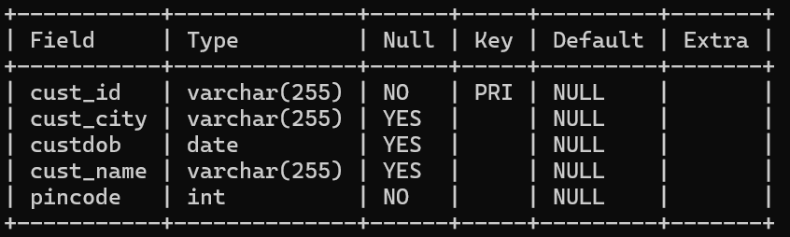
System Architecture
Customer Management :
Centralized system for managing customer data
Includes functionalities for adding, updating, deleting, and retrieving customer information
Essential for maintaining accurate customer records and enhancing user experience
Customer Data Model :

Slide 7
System Architecture
Exception Handling:
CustomerNotFoundException : Handles cases where customer information is not found.
Validation Errors : Manages issues related to invalid data input or constraints.
Integration with Other Modules:
Cart Management : Associates customer data with shopping carts.
Order Processing : Links customer data to orders for tracking and management.
Inventory Management : Ensures that customer orders are processed based on available stock.

Slide 8
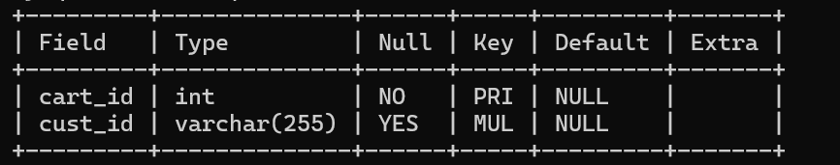
System Architecture
Cart Management:
Central hub for managing user shopping carts
Integrates with user profiles and inventory for streamlined shopping
Facilitates operations like adding, updating, and removing items, as well as placing orders
Cart Data Model:

Slide 9
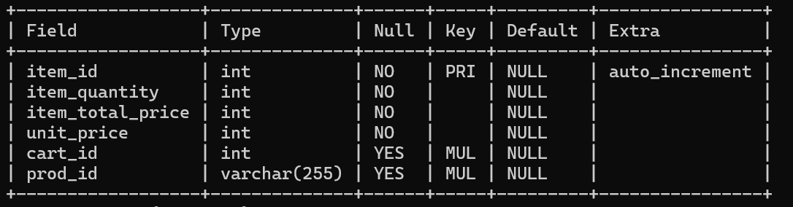
System Architecture
Line Item Data Model:
Integration with Other Modules:
Customer Data: Associates cart with customer details for personalized service
Order System: Links cart contents directly to the order system for efficient checkout
Inventory Check: Synchronizes cart with inventory levels to manage product availability

Slide 10
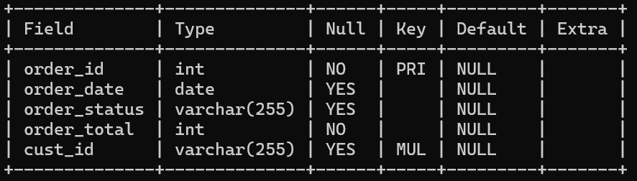
System Architecture
Order Processing:
Manage the lifecycle of customer orders from placement to fulfillment
Works seamlessly with cart, inventory, and customer management systems
Order creation, status tracking, and cancellation
Order Data Model:

Slide 11
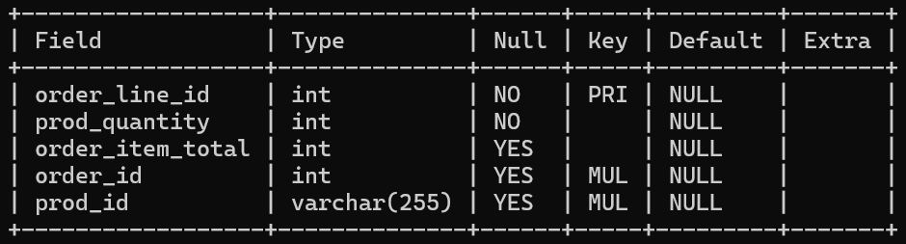
System Architecture
Order Line Data Model:
Integration with Other Modules:
Cart Management: Pulls items from the cart to create the order
Customer Data: Associates orders with customer profiles for tracking and history
Inventory System: Updates inventory levels based on the ordered items

Slide 12
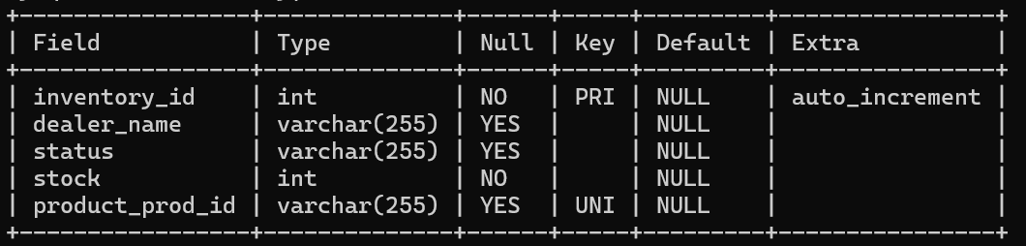
System Architecture
Inventory Management:
Efficiently manage stock levels, track inventory status, and support product availability
Works seamlessly with product, order, and cart management systems
Inventory tracking, updates, and status management
Inventory Data Model:

Slide 13
System Architecture
Integration with Other Modules:
Product Management: Links inventory levels to specific products
Order Processing: Adjusts inventory levels based on orders placed
Cart Management: Updates stock availability as items are added or removed from carts
Inventory Workflow:
Inventory Addition: Adds new stock to the system with product details
Inventory Update: Modifies existing inventory records as needed
Inventory Status: Monitors and updates the status of inventory items

Slide 14
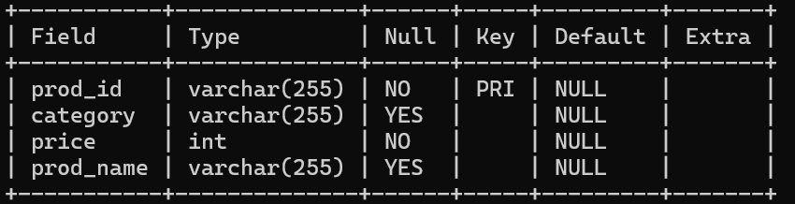
System Architecture
5. Product Management :
Enables the addition of new products with comprehensive details
Allows modifications to existing product information
Facilitates product searches by name, category, and price
Product Data Model :

Slide 15
System Architecture
Exception Handling:
ProductNotFoundException: Handles errors related to missing products.
Validation Errors : Manages issues related to invalid data input or constraints.
Integration with Other Modules:
Inventory Management: Links product details to inventory records
Cart Management: Ensures product details are accurate when added to carts
Order Processing: Reflects accurate product information in orders

Slide 16
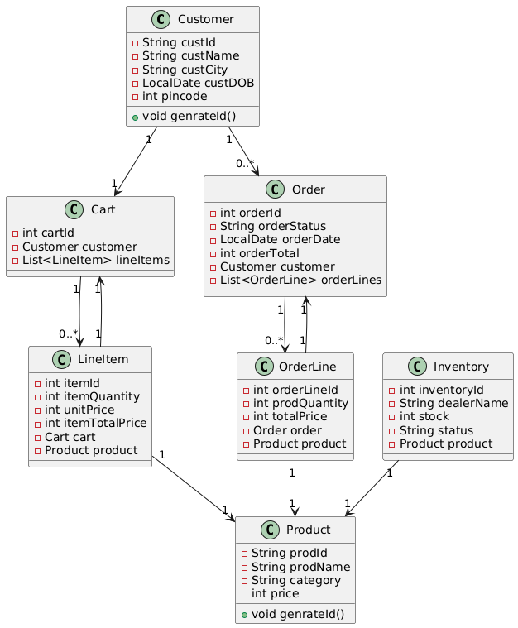
Class Diagram

Slide 17

vTechnology & Tools Used : Module Structure
SpringBoot
JPA
Mysql
Postman
Swagger
IntelliJ

Slide 18

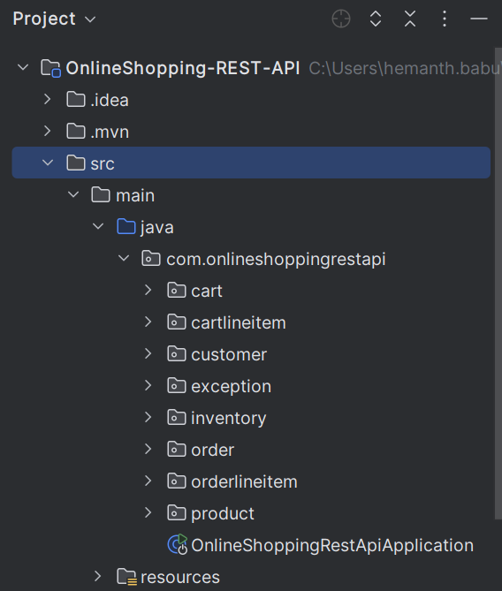
Project Module Structure

Slide 19
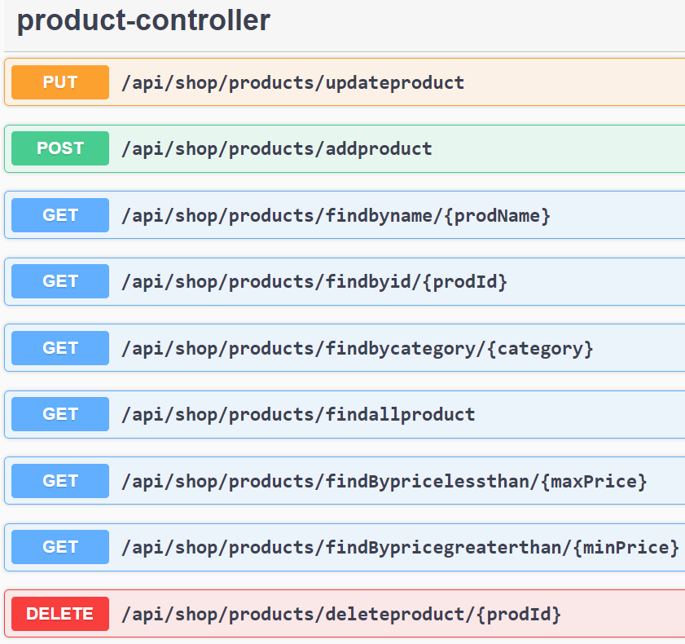
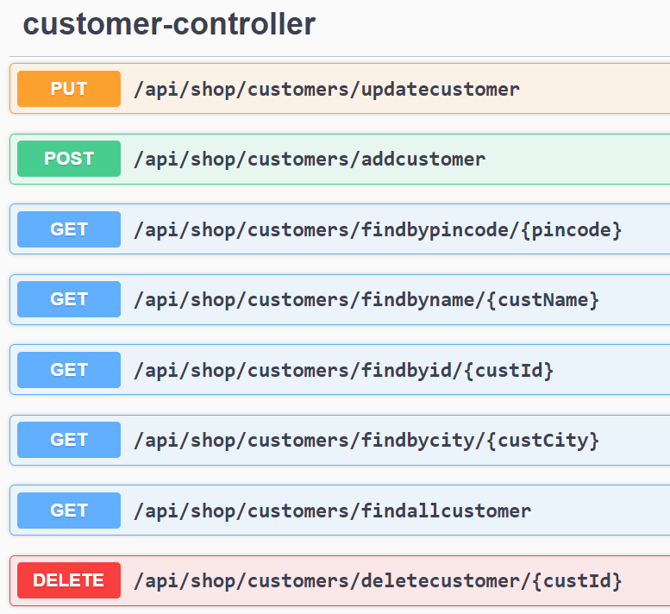
Product Controller & Inventory Controller With Endpoints

Slide 20
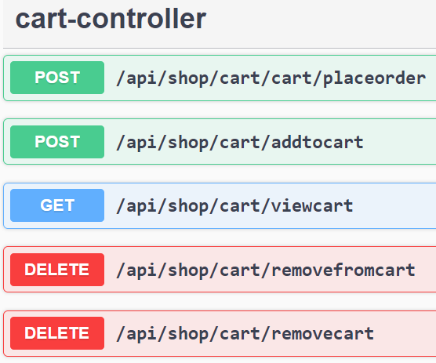
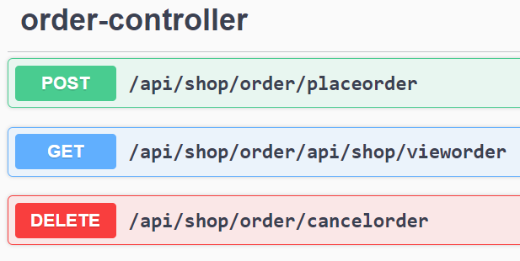
Cart Controller & Order Controller With Endpoints

Slide 21
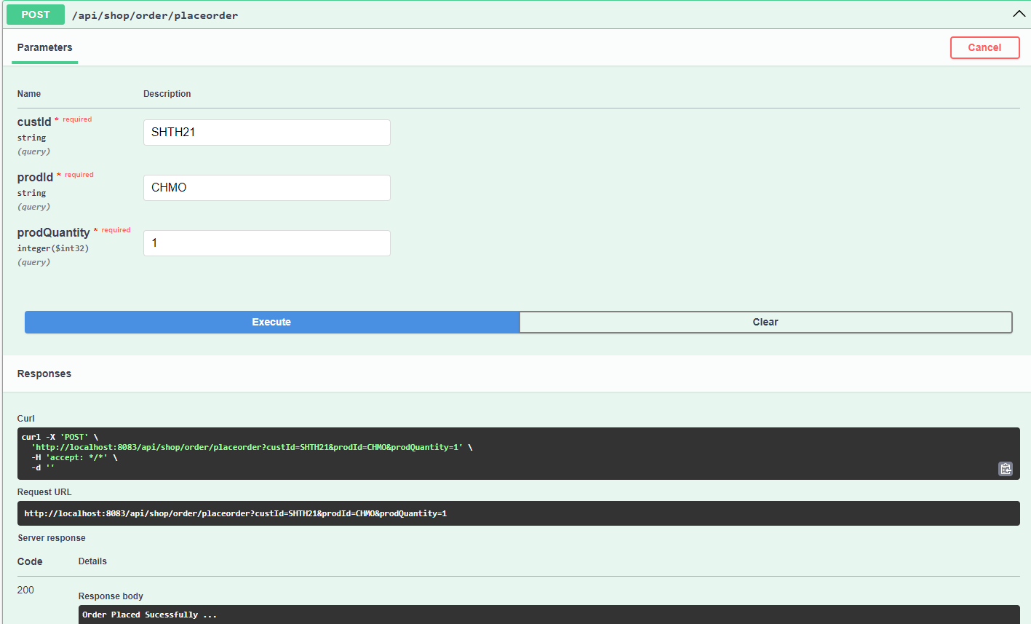
Direct Checkout For Product

Slide 22
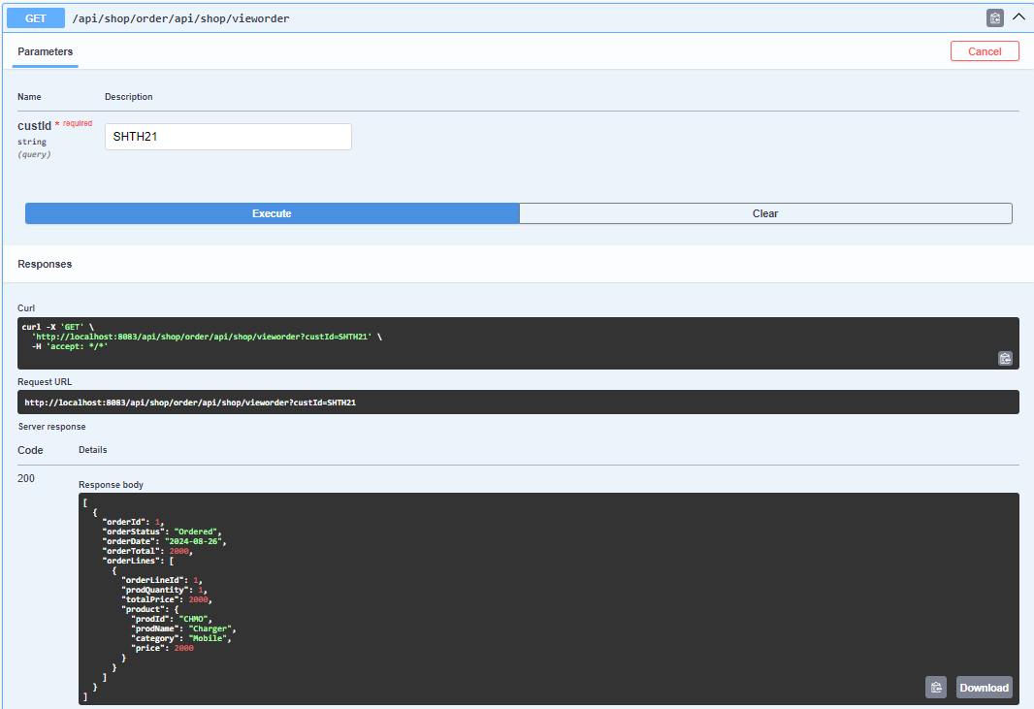
View Order

Slide 23
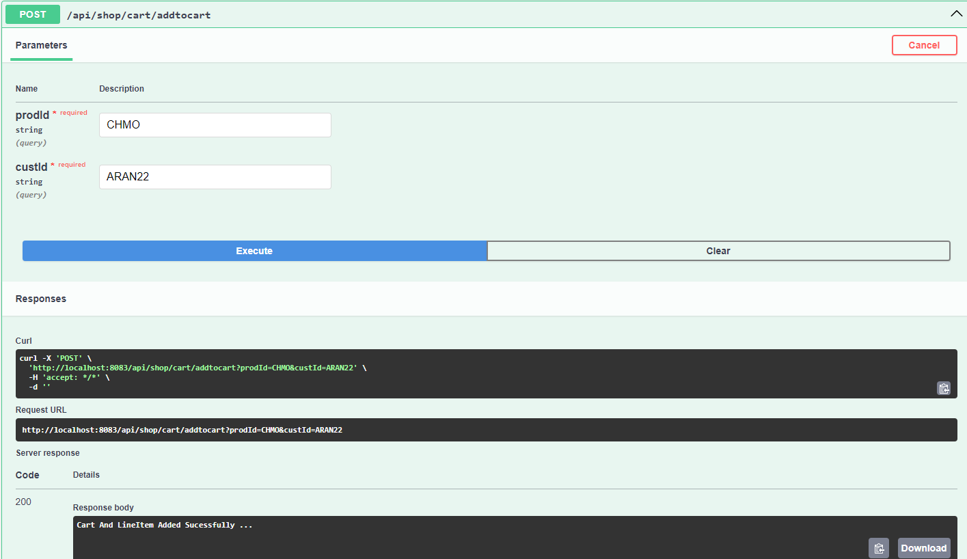
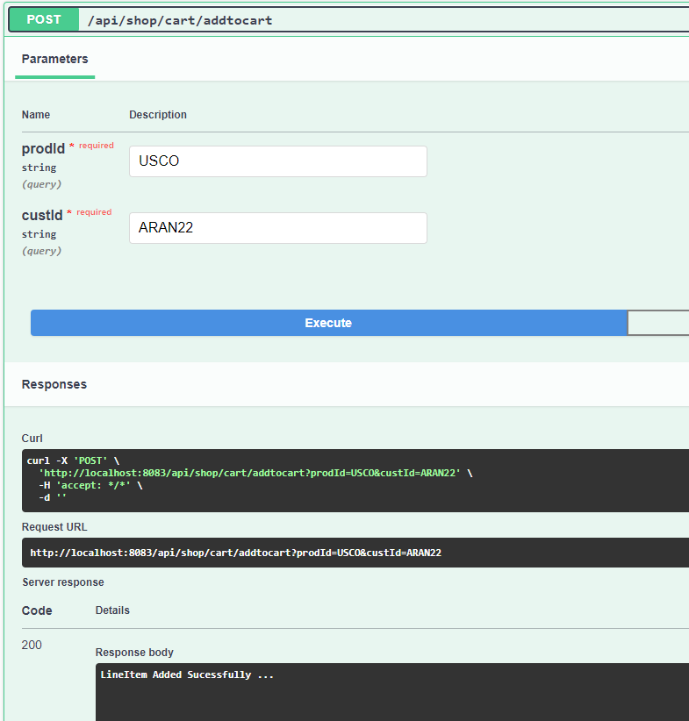
Add To Cart For Customer

Slide 24
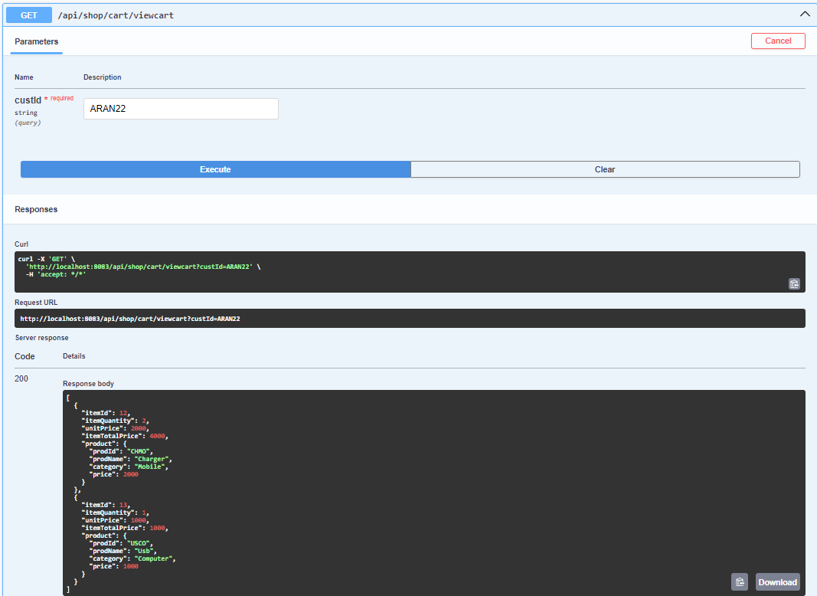
View Cart For Customer

Slide 25
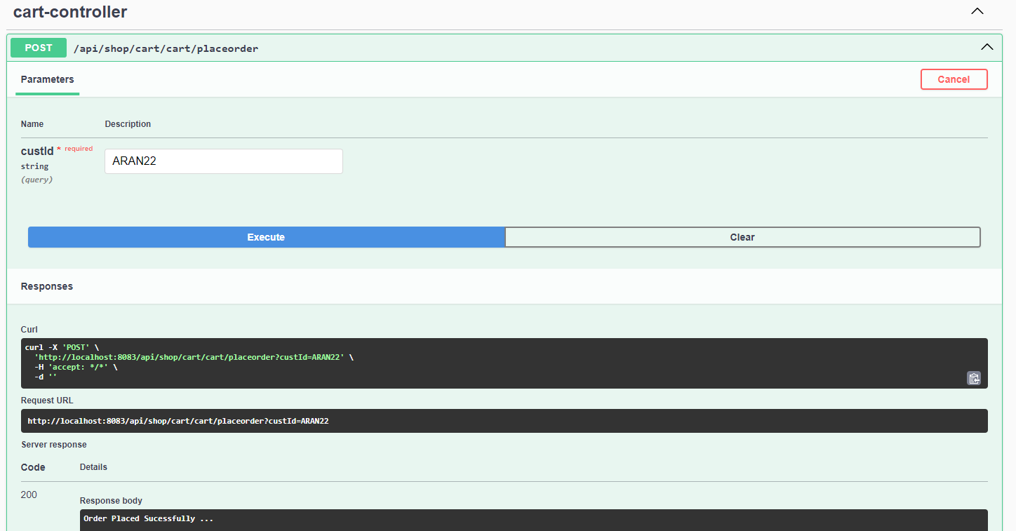
Order From Cart

Slide 26
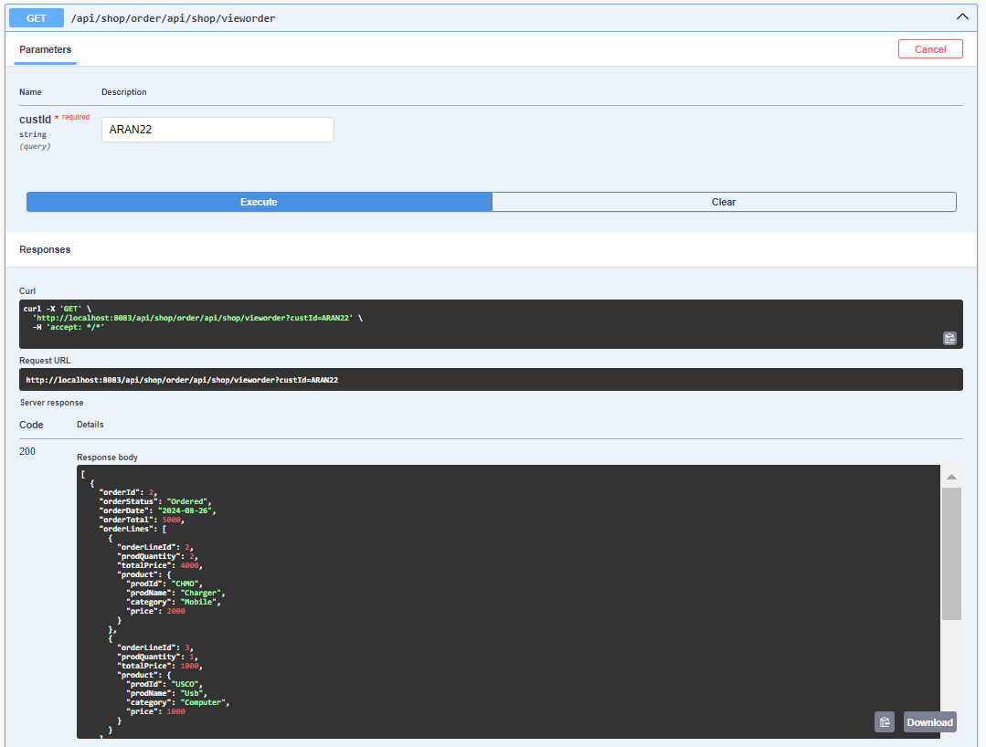
View Order

Slide 27
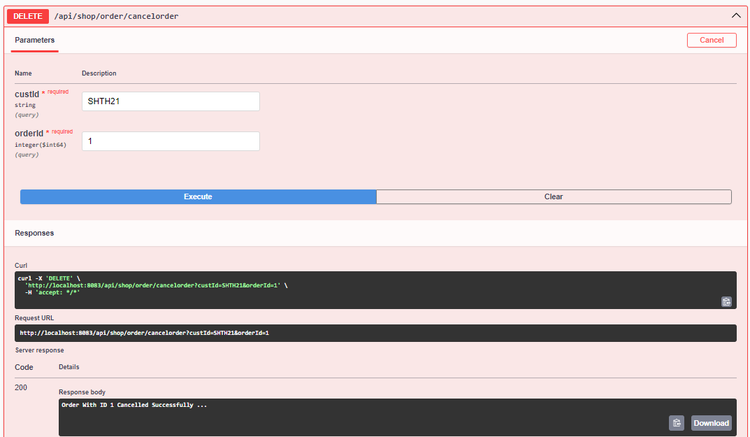
Cancel Order

Slide 28
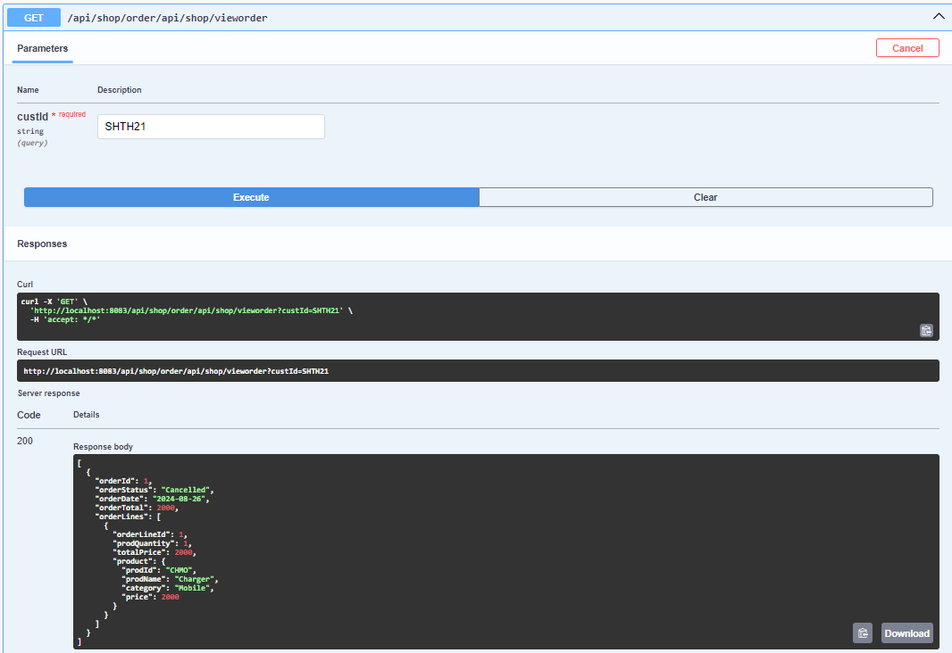
View Order

Slide 29
Conclusion
The newly implemented backend system addresses critical challenges in the online shopping application by leveraging advanced controllers and services for managing customers, carts, orders, inventory, and products. With robust features for customer profile management, efficient cart handling, dynamic order processing, and real-time inventory tracking. The backend solution significantly enhances the overall shopping experience, supporting scalability and responsiveness in a competitive e-commerce landscape.

Slide 30
Thank You

